Slide 1
NAVY ECONOMICS
With Petty Officer:

Slide 2
A LITTLE ABOUT ME:
Insert mini bio here…
Also some pictures

Slide 3
Presentation topics:
Learn about the basics of the American Income Tax System
Learn about Cost of Living and different factors that can affect it
Learn about compound interest, its affect on retirement, and the difference in investing at different points in your life
For each topic, we will also learn about Navy programs related to them

Slide 4
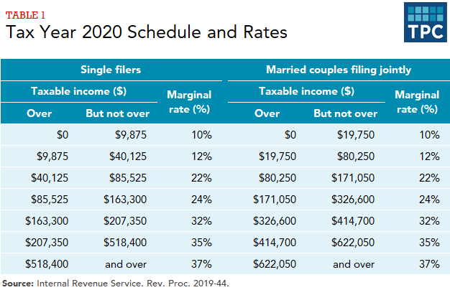
Income Tax (This is not financial advice)
The Federal Government utilizes a Progressive Tax System
A Progressive Tax System means that only the part of your salary in each bracket is paid at that rate
In contrast, a Flat Tax System taxes the entire salary at a single rate

Slide 5
Income Tax (Still not financial advice)
For Example:
Say you make $65,000 a year:
The first $9875 is taxed at 10%
The next $30,250 will be taxed at 12%
The last $24,875 would be taxed at 22%
Because only a portion of your pay is taxed, will never lose money by making more money

Slide 6
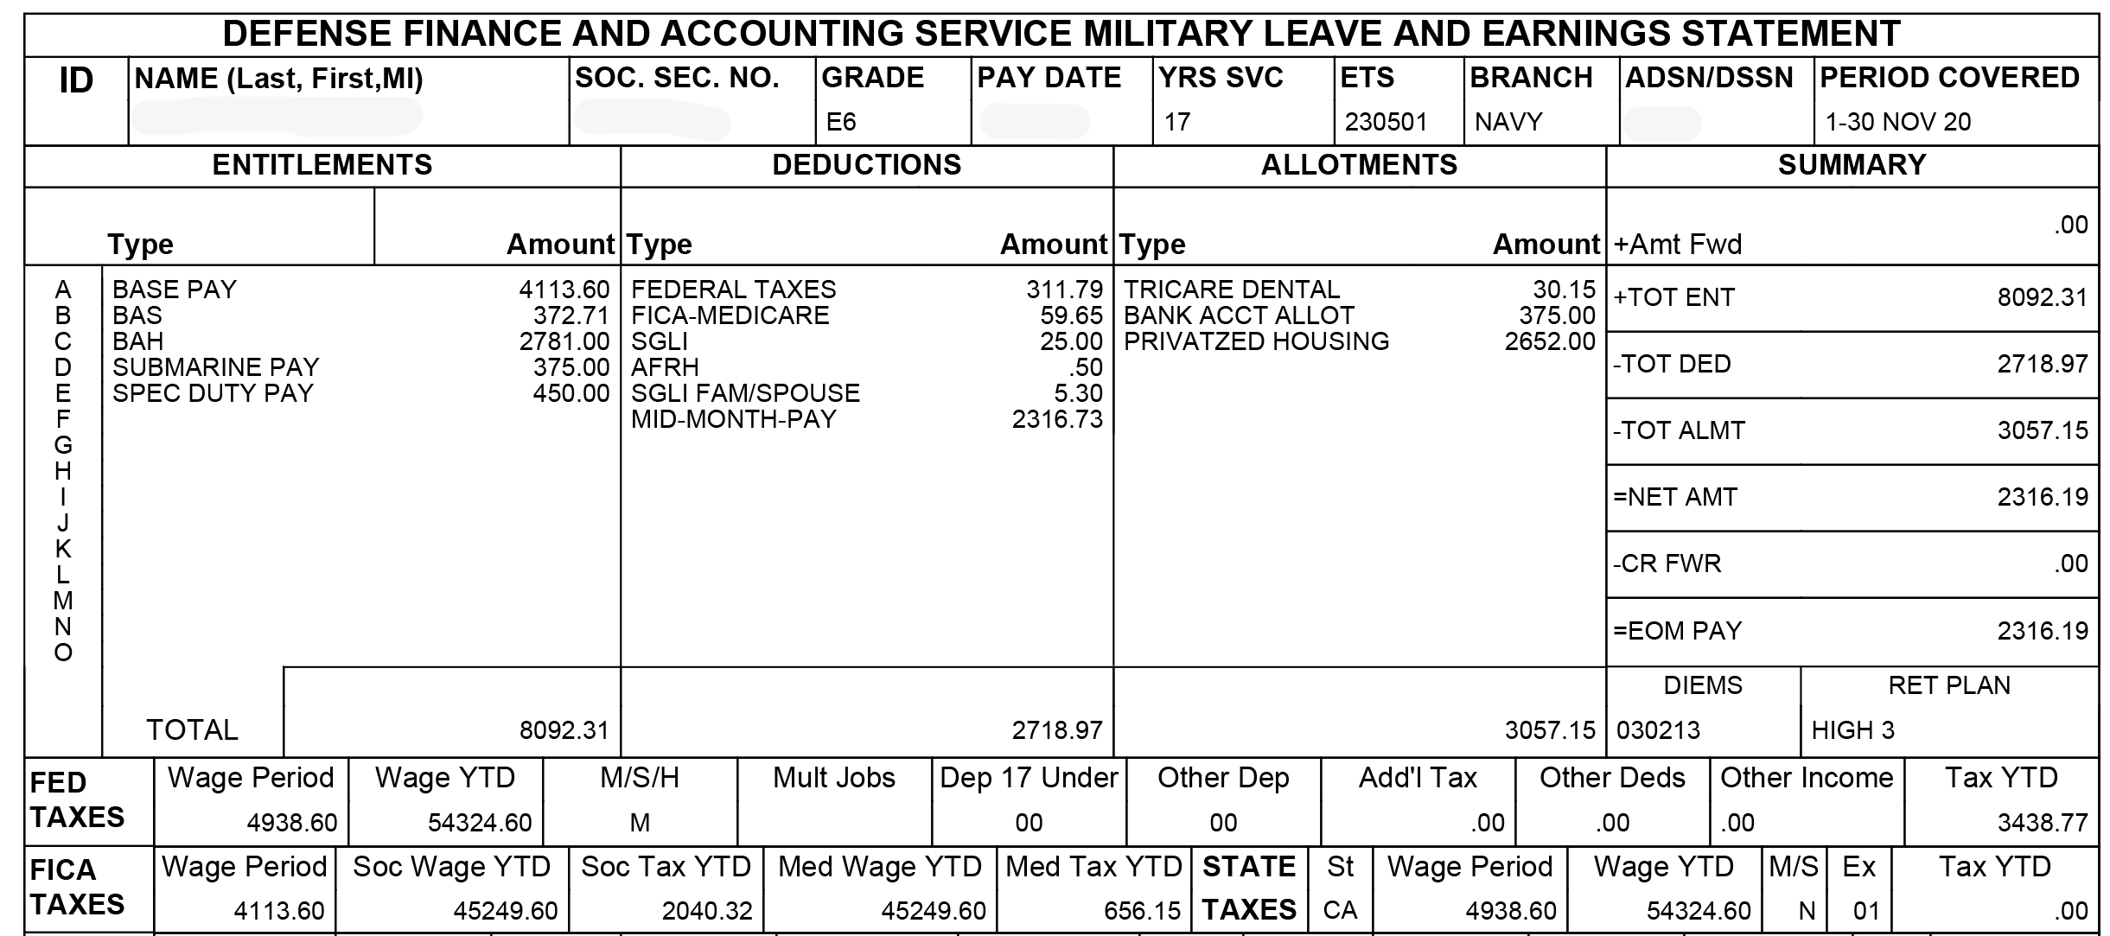
Advantage of the Navy Paycheck
This is a Leave and Earning Statement, a military pay stub
Notice anything interesting?

Slide 7
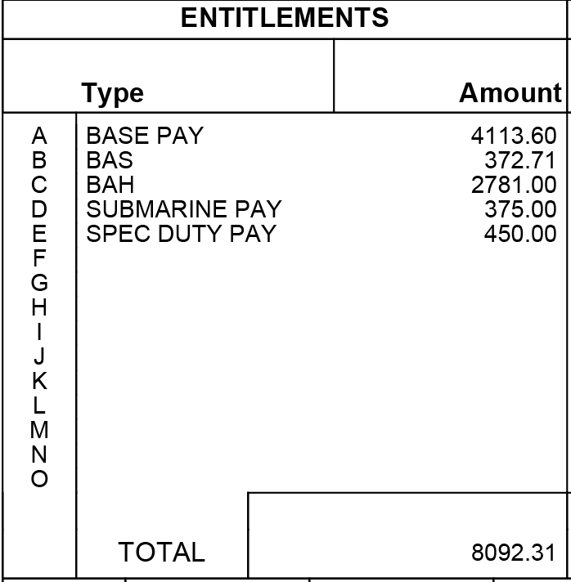
Advantage of the Navy Paycheck
Not all of our paycheck is taxed

Slide 8
Advantage of the Navy Paycheck
BAH and BAS stand for Basic Allowance for Housing and Basic Allowance for Sustenance

Slide 9
Advantage of the Navy Paycheck
Allowances are parts of our pay designated for specific purposes, as a result its not taxed
As a result we are only taxed on roughly half of what we’re actually paid

Slide 10
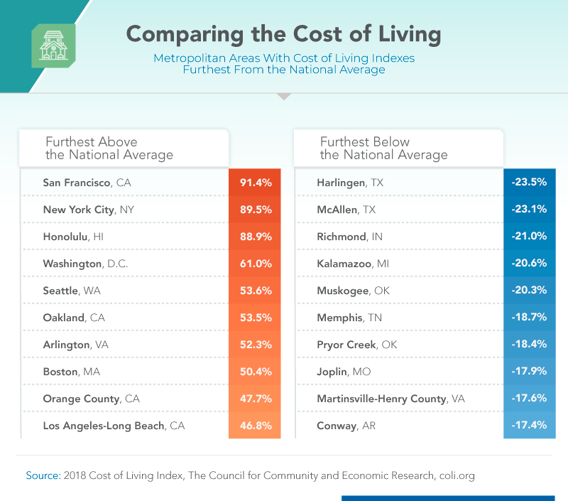
Cost of Living
From Investopedia: The cost of living is the amount of money needed to cover basic expenses such as housing, food, taxes, and healthcare in a certain place and time period. The cost of living is often used to compare how expensive it is to live in one city versus another. The cost of living is tied to wages. If expenses are higher in a city, such as New York, for example, salary levels must be higher so that people can afford to live in that city.

Slide 11
Cost of Living
Cost of living is volatile and changes over time.
In general, the biggest drivers for Cost of Living is Rent, Taxes, and Child Care
Some places, such as Hawaii, have High Cost of Living due to their isolated location

Slide 12
Cost of Living
Let’s try an experiment:
How much will it cost to live in the following places:
Los Angeles
Biloxi
Cedar Rapids
Cost of Living Calculator

Slide 13
How does the Navy help you with that?
The Navy’s BAH rate is based off of location, meaning if you live in a higher cost area, you get more money for rent
Certain locations have access to a Cost of Living Allowance (COLA) that helps defer costs
In addition, benefits like Comprehensive Medical Insurance and Tuition Assistance help keep our costs down
BAH Calculator

Slide 14
Retirement Definitely not financial advice
No matter your age, retirement is something to start thinking about early
Over half of Americans under 40 have a retirement account
25% across any age have no retirement

Slide 15
Retirement Planning Seriously, this is not financial advice, but it is math
There’s many different ways to save for retirement including:
IRAs
Roth IRAs
401K
403b
They vary but all utilize the same basic principle

Slide 16
Retirement Planning Seriously, this is not financial advice, but it is math
Compound Interest:

Slide 17
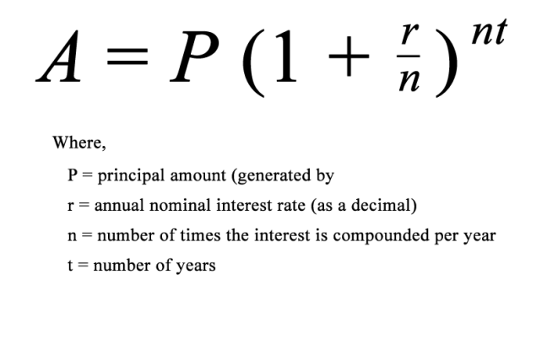
Retirement Planning Seriously, this is not financial advice, but it is math
Compound Interest:
The secret is that you continually reinvest what you make, so that when it comes time to pay interest, your principle is higher

Slide 18
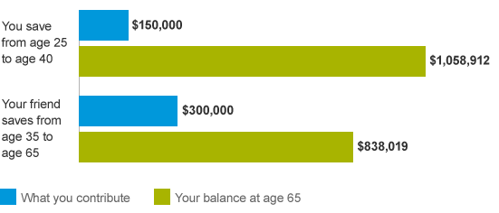
Retirement Planning Seriously, this is not financial advice, but it is math
Compound Interest:
Simply put, the more money you put in and the earlier you start saving the more money you will have later, even if you stop investing later:

Slide 19
Retirement Planning Seriously, this is not financial advice, but it is math
So what’s the Navy’s Retirement plan?
Since 2018 the military has utilized a Blended Retirement System
This a combination of the Thrift Savings Plan and traditional Pension

Slide 20
Retirement Planning Seriously, this is not financial advice, but it is math
2 parts:
Part 1
You invest a percentage of your paycheck in your Thrift Savings Plan
The Navy will match you up to 5%
You keep this account regardless of how long you stay in the military
You can begin to use this money as early as 59

Slide 21
Retirement Planning Seriously, this is not financial advice, but it is math
2 parts:
Part 2
Staying in the military to 20+ years also provides you a pension upon retirement
It starts at 40% of your basic pay and goes up 2% per year up to 60%

Slide 22
Retirement Planning Seriously, this is not financial advice, but it is math
What’s this worth?
Blended Retirement Calculator
Notes:
Click: Get Started
2. Set Born: Jan 2000
3. Entry Date: Decemember 2020
4. Current Grade: E-2
5.Estimate Service at separation: 5 years
6. Opt-in: Feb 2021
7. Life Expectancy: 80
8. TSP Withdrawl: 59 Years
9. Leave Contribution Rate and set rate of return to: 8.5%
10. Don’t override anything
11. Bonus and Payments: Continue
12. Lump Sum: Continue
Total Retirement Package: $488,263
Second Round:
Click: Get Started
2. Set Born: Jan 2000
3. Entry Date: Decemember 2020
4. Current Grade: E-2
5.Estimate Service at separation: 20 years
6. Opt-in: Feb 2021
7. Life Expectancy: 80
8. TSP Withdrawl: 59 Years
9. Leave Contribution Rate and set rate of return to: 8.5%
10. Don’t override anything
11. Bonus and Payments: 2.5, 12, 4, 1, 50%
2. Lump Sum: 25%/1
Total Retirement Package: $4,670,614

Slide 23
In Review
We reviewed the following topics today:
Learn about the basics of the American Income Tax System
Learn about Cost of Living and different factors that can affect it
Learn about compound interest, its affect on retirement, and the difference in investing at different points in your life
While everyone’s path is different, service in the Navy can be a springboard for financial security, regardless if you do one tour, or 30 years

Slide 24
QUESTIONS???

